Slide 1
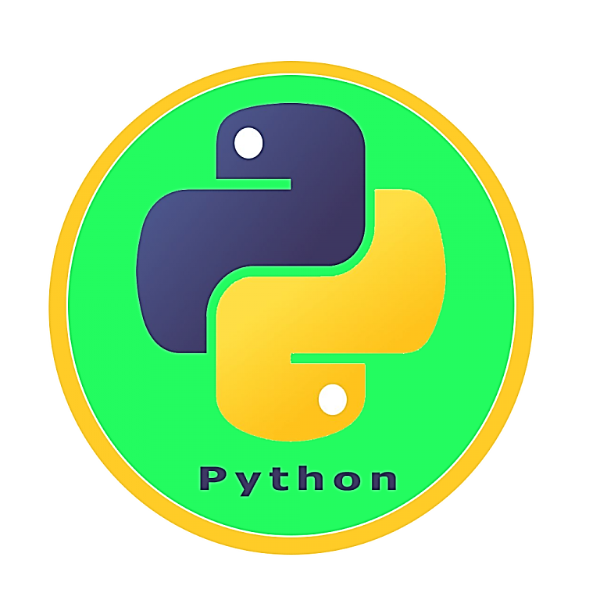

Introduction to Python Programming
By Chakin

Slide 2
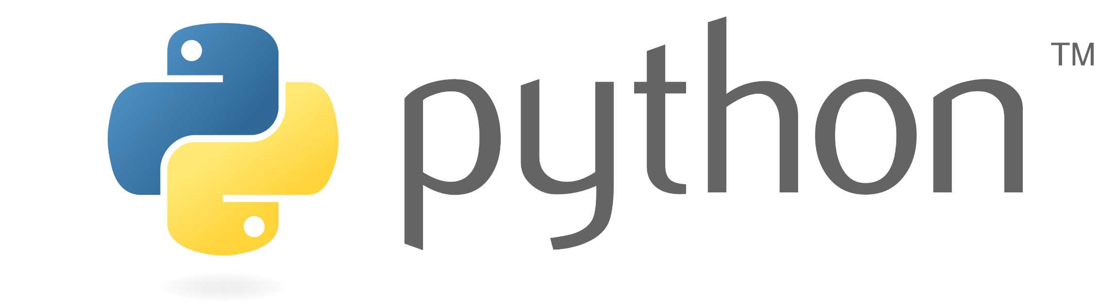

What is Python?
- Python is a high-level, interpreted programming language created by Guido van Rossum and first released in 1991.
- Known for its readability and simplicity, making it ideal for beginners and experts alike.
- Widely used in web development, data analysis, artificial intelligence, scientific computing, and more.

Slide 3
Key Features of Python
- Easy to Learn and Use: Simple syntax that mimics natural language.
- Interpreted Language: Executes code line by line, which makes debugging easier.
- Versatile and Powerful: Supports various programming paradigms (procedural, object-oriented, functional).
- Extensive Libraries and Frameworks: Access to a wide range of libraries like NumPy, Pandas, Matplotlib, Django, Flask, etc.
- Community Support: Large and active community.

Slide 4
Python Syntax and Basics
- Indentation: Indentation is crucial in Python as it defines the scope of loops, functions, classes, etc.
- Variables and Data Types: Dynamic typing, common data types (int, float, str, list, tuple, dict).
- Basic Operations: Arithmetic operations, string manipulations.

Slide 5
Python Syntax Continued:
Indentation
Basic Operations
Data Types
# Variable declaration
x = 5 # Integer
y = 3.14 # Float
name = "Alice" # String
is_valid = True # Boolean
# List
fruits = ["apple", "banana", "cherry"]
# Tuple
point = (10, 20)
# Dictionary
person = {"name": "Alice", "age": 25}
# Correct Indentation
if True:
print("This is indented properly")
# Incorrect Indentation
if True:
print("This will raise an IndentationError")
# Arithmetic operations
sum = x + y
difference = x - y
product = x * y
quotient = x / y
# String operations
greeting = "Hello, " + name
shouting = name.upper()

Slide 6
Control Structures
Conditional Statements: if, elif, else.
age = 18
if age >= 18:
print("You are an adult.")
elif age > 12:
print("You are a teenager.")
else:
print("You are a child.")
- List Comprehensions: A concise way to create lists.
# List comprehension
squares = [x**2 for x in range(10)]
print(squares)
Loops: for, while.
# For loop
for i in range(5):
print(f"i is {i}")
# While loop
count = 0
while count < 5:
print(f"count is {count}")
count += 1

Slide 7
Functions in Python
- Defining Functions: Using the `def` keyword.
def greet(name):
return f"Hello, {name}!"
print(greet("Alice"))
- Arguments and Return Values: Positional and keyword arguments.
def add(a, b):
return a + b
result = add(5, 3)
print(result)
- Lambda Functions: Anonymous functions.
# Lambda function
multiply = lambda x, y: x * y
print(multiply(4, 5))

Slide 8
Modules and Packages
- Modules: Reusable pieces of code, using `import` to include them.
- Standard Library: Overview of commonly used modules like os, sys, math, datetime.
- Packages: Collections of modules, using `pip` to install packages.
# Installing a package using pip (command to run in the terminal or command prompt)
pip install numpy
# Alternatively, for Python 3, you might need to use:
pip3 install numpy

Slide 9
Importing Modules and Standard Libraries
# Importing a module
import os
# Using a function from the os module
current_directory = os.getcwd()
print(current_directory)
# Importing a specific function from a module
from math import sqrt
# Using the imported function
result = sqrt(16)
print(result)
# Using the sys module to access command-line arguments
import sys
print("Script name:", sys.argv[0])
if len(sys.argv) > 1:
print("First argument:", sys.argv[1])
# Using the datetime module to work with dates and times
import datetime
current_time = datetime.datetime.now()
print("Current time:", current_time)

Slide 10
Working with Data
Reading and Writing Files: Handling text and CSV files.
# Reading a file
with open('example.txt', 'r') as file:
content = file.read()
print(content)
# Writing to a file
with open('example.txt', 'w') as file:
file.write("Hello, World!")

Slide 11
Working with Data Continued:
import numpy as np
import pandas as pd
# NumPy array
arr = np.array([1, 2, 3, 4, 5])
print(arr)
# Pandas DataFrame
data = {'Name': ['Alice', 'Bob', 'Charlie'], 'Age': [25, 30, 35]}
df = pd.DataFrame(data)
print(df)
import matplotlib.pyplot as plt
# Simple plot using Matplotlib
x = [1, 2, 3, 4, 5]
y = [2, 3, 5, 7, 11]
plt.plot(x, y)
plt.xlabel('x-axis')
plt.ylabel('y-axis')
plt.title('Simple Plot')
plt.show()
- Data Analysis Libraries: Introduction to NumPy and Pandas
- Data Visualization: Using Matplotlib and Seaborn.

Slide 12
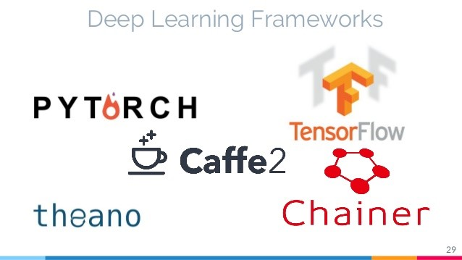
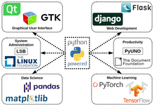
Real-World Applications
- Web Development: Frameworks like Django and Flask.
- Data Science and Machine Learning: Libraries like SciPy, Scikit-Learn, TensorFlow, Keras.
- Automation: Scripting and automation with Python.
- Game Development: Libraries like Pygame.

